Slide 1

Length of Stay in Hospital
Presented by: Team 3
Vaishnav Kaldate
Yash Javalkar
Harsh Panchal

Slide 2
About the Data Set
The dataset predicts the length of stay for patients admitted to a hospital-based on various indicators of their health condition.
This dataset contains 100,000 data points on patients admitted to the hospital. It includes information of their health condition and the length of their stay in the hospital. In this analysis, two outcome variables will be predicted: the length of hospital stay (Numerical) (Dependent “Y”) and the depression (Categorical / binary) (Dependent “Y”).
No. of Columns: 25
No. of Rows: 100,000
Categorical X variables:
gender, asthma, dialysis renalendstays, iron def, penum, substance dependence, psychological disorders major, depress, psychother, fibrosis another, malnutrition, hemo, facid
Numerical X variables:
rcount, hematocrit, neutrophils, sodium, glucose, blood urea nitro, creatinine, bmi, pulse, respiration, secondary diagnosis non icd9, length of stay

Slide 3
Study Questions
Can we identify the length of stay for patients admitted to the hospital based on their health indicators and other relevant factors?
Based on the health indicators of patient how likely is the patient mentally stable (depressed) ?
Is there a linear relationship between the predictor variables and length of stay in the hospital?

Slide 4
Recap: Analysis Plan
Clean the data.
Run Linear Regression on Training Model
Run Best Subset Model
Run Logistic Regression Model for different “Y” variable
Check two assumptions Linearity
Run the Tree Based Model
Perform the Random Forest

Slide 5
Linear Regression Model
We created two different MLR models one with the known variables and other with the unknown variables. The reason was that the variables were correlated with each other.
In model 1 we consider the parameters like (Gender, asthma, rcount) and its adjusted R squared value is 71.15% which means 71.15% of the variance in the data set is explained by the model which is decent and RMSE is less 1.25 which the model is off by 1 day
Secondly, we also created model2 that contains all the unknown parameters while going to the hospital, but the model failed to explain the maximum variance in the data set with only 6% and a larger RMSE of 2 days average off from the mean

Slide 6
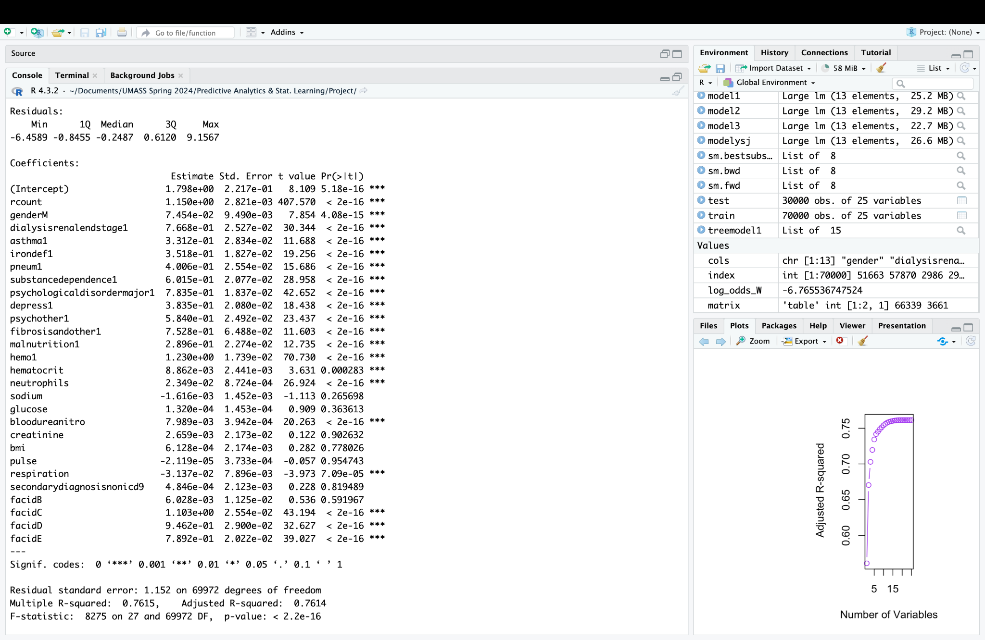
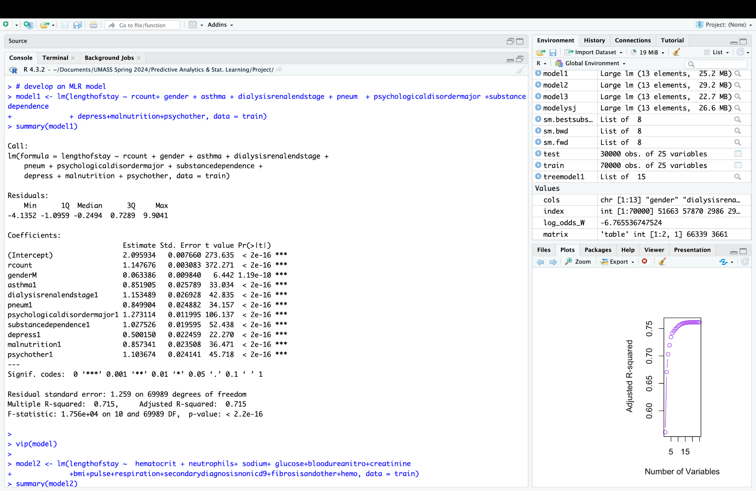
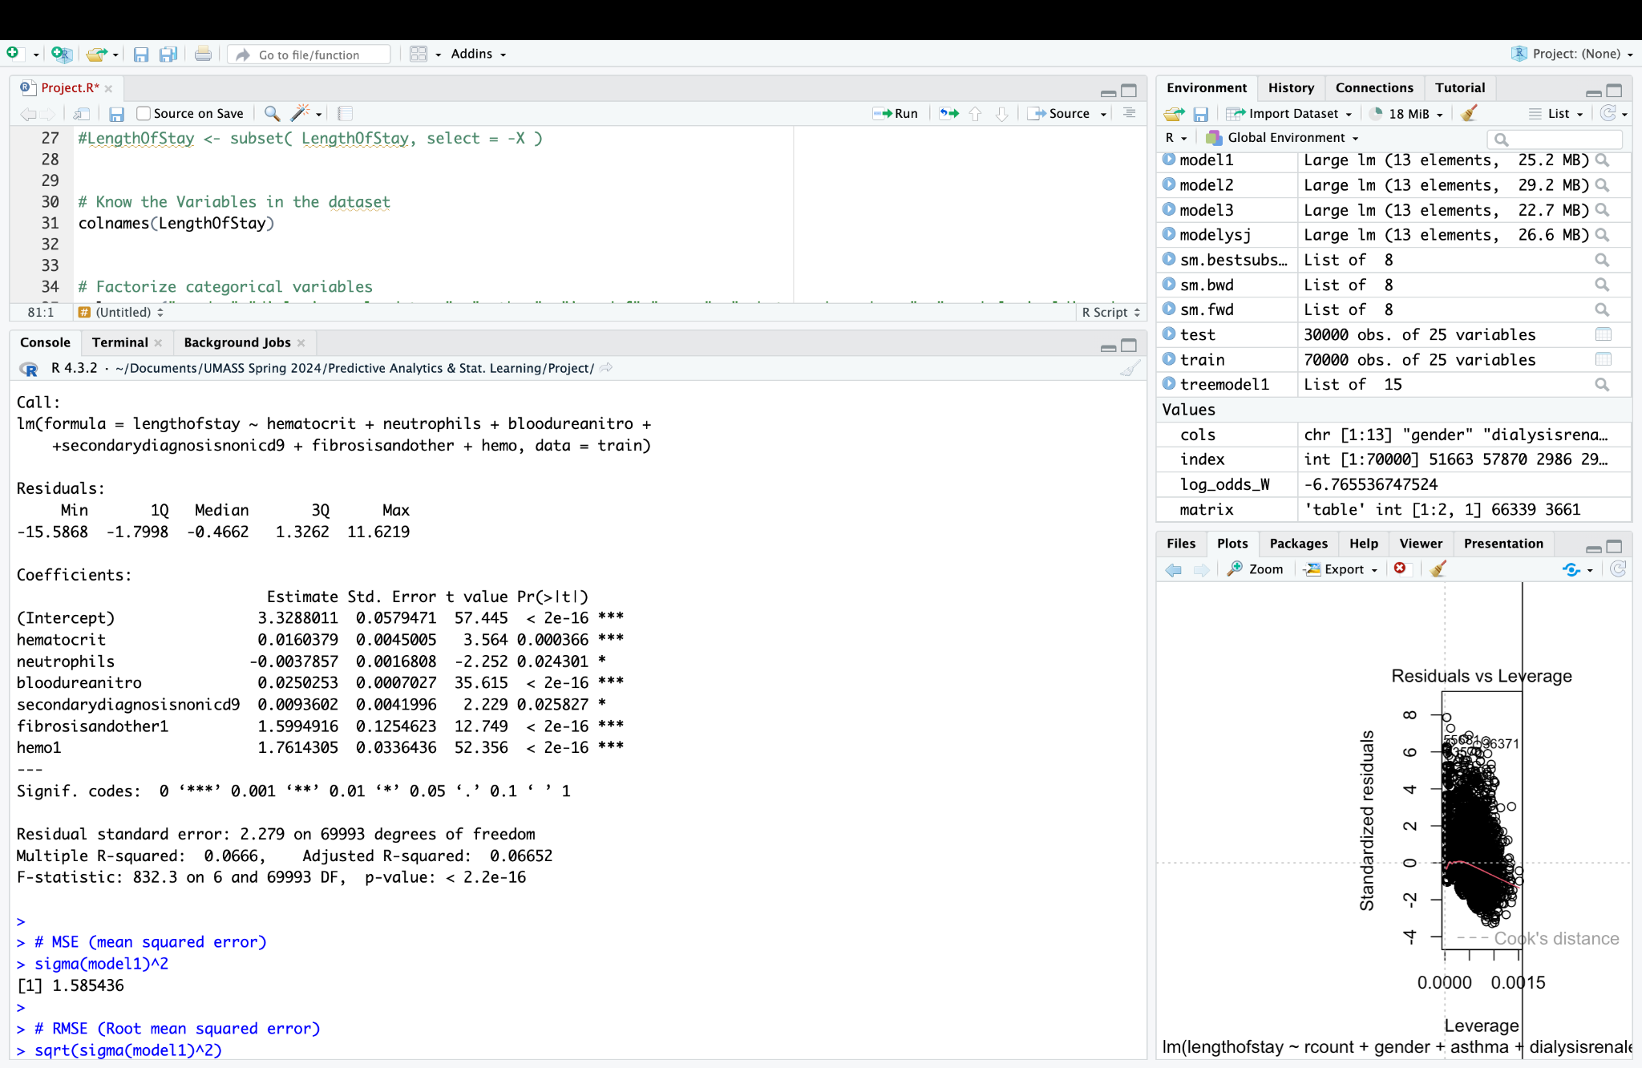
Linear Regression with all variables
Linear Regression with Known variables
Linear Regression with Unknown variables

Slide 7
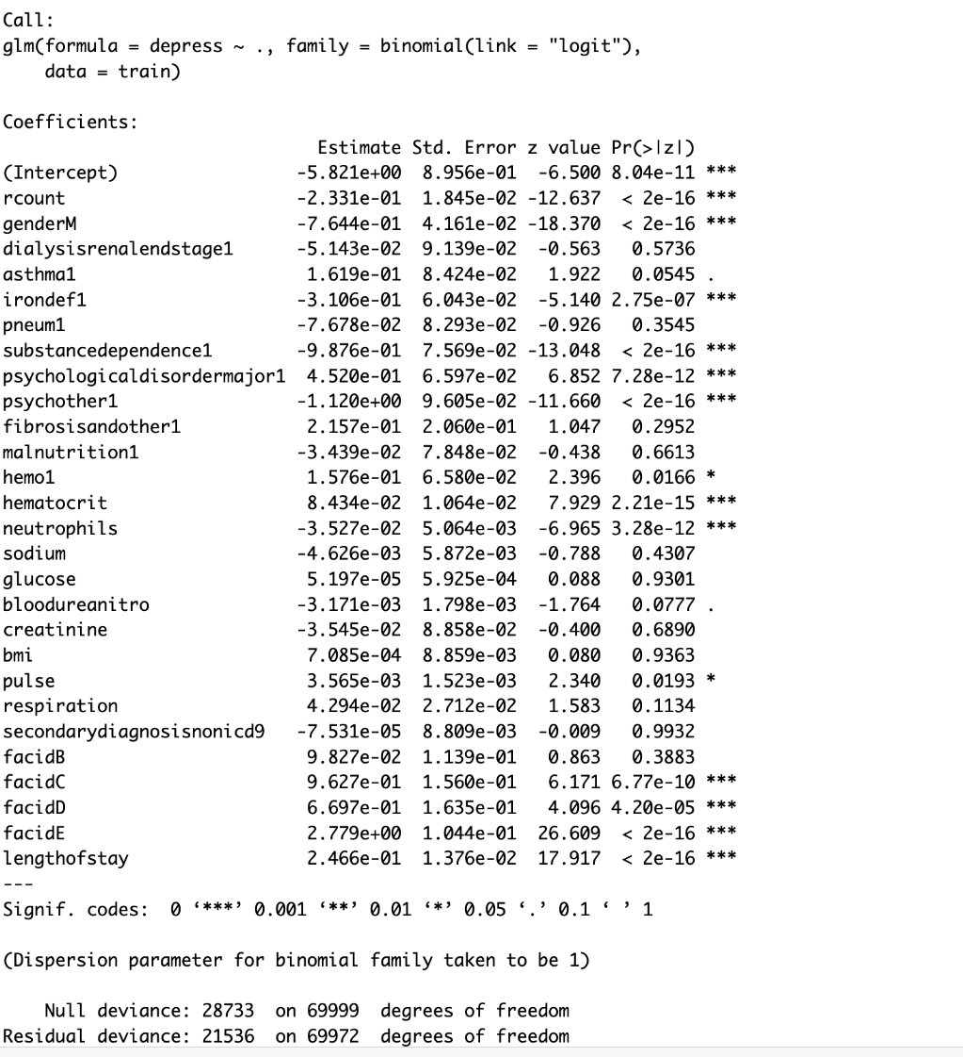
Logistic Regression Model
We employed a logistic regression model to predict the likelihood of depression (variable Y) as a categorical outcome based on an individual's health indicators, particularly considering the presence of multiple diseases.
As the precision and recall are less 54, 46 then we used the best subset model to only select variables which are highly significant which will increase the precision and recall of the model.

Slide 8
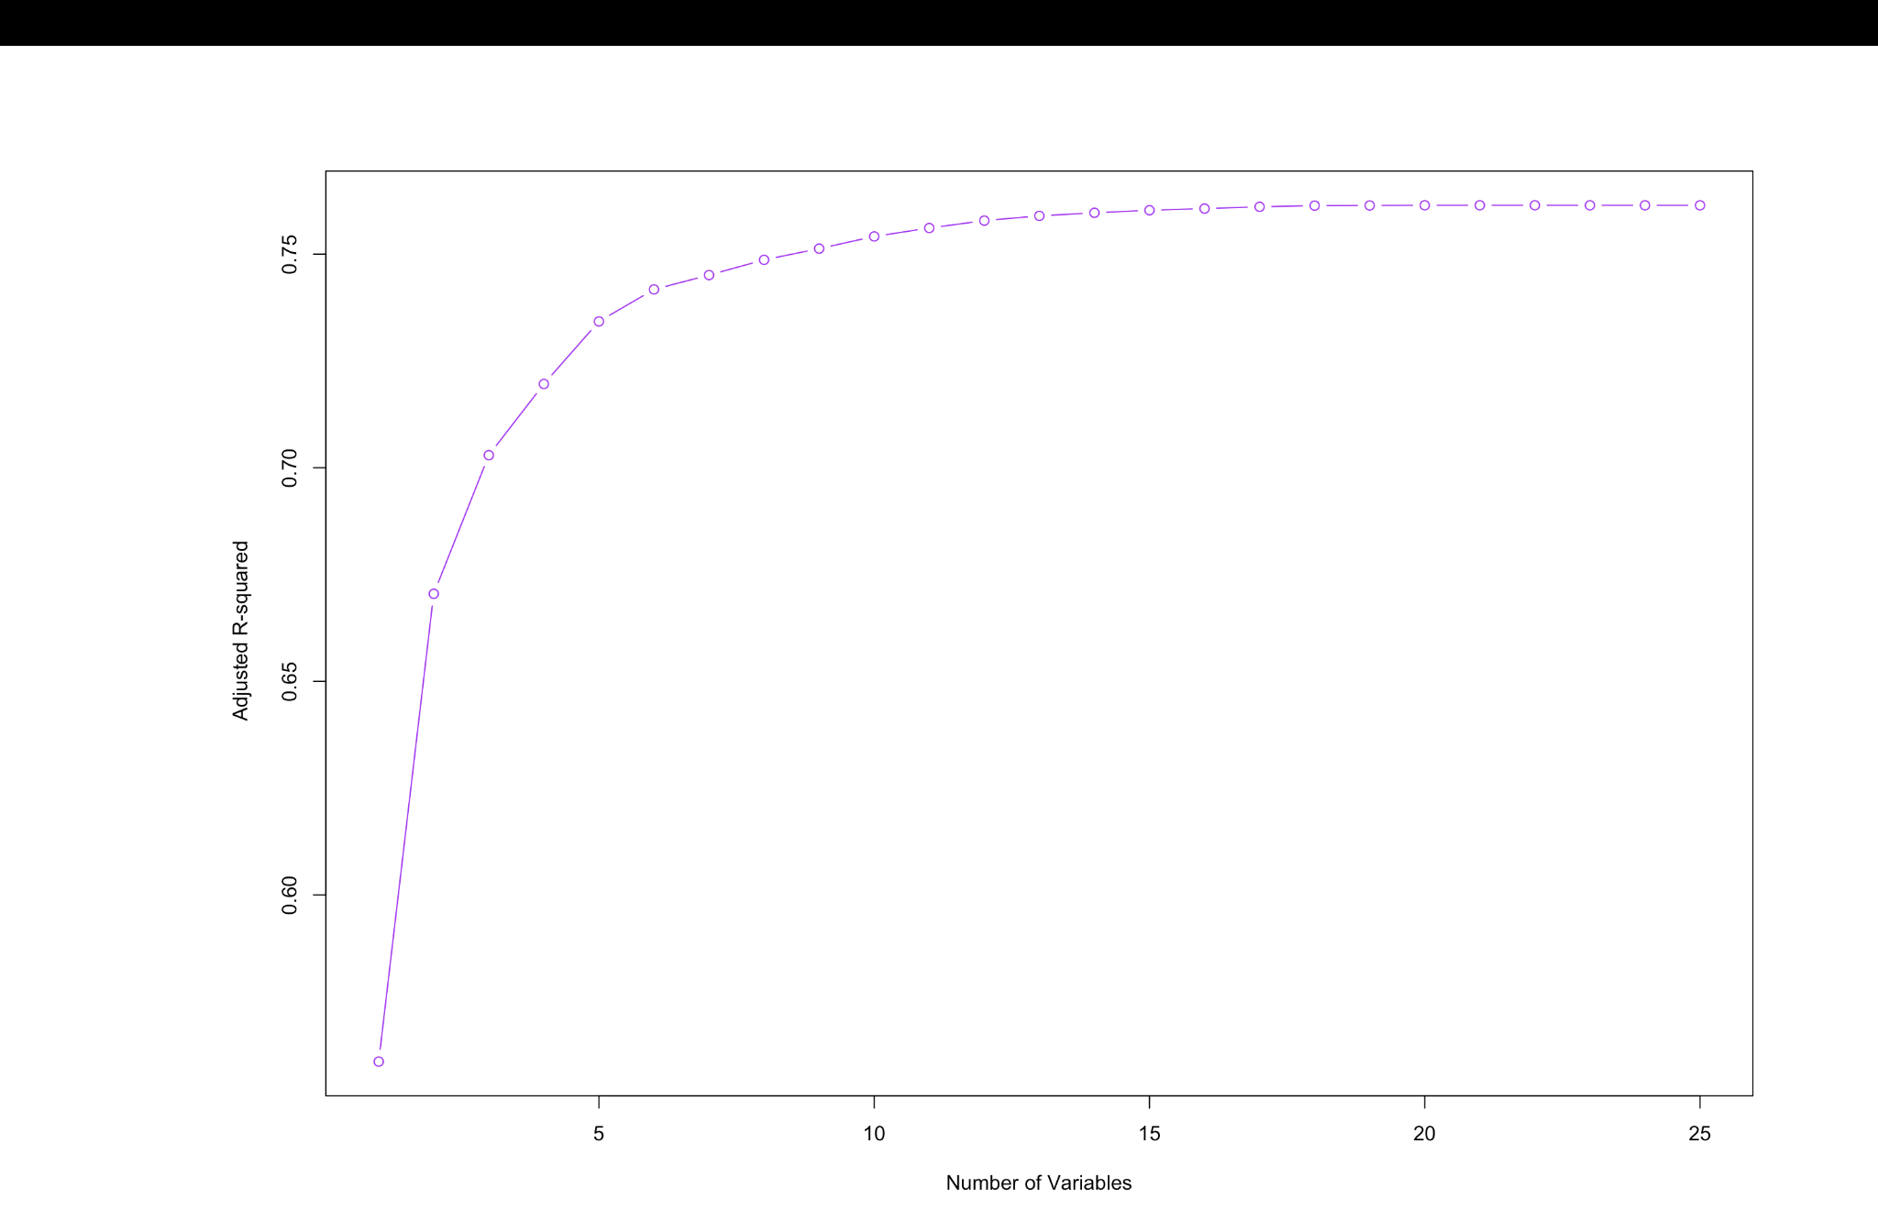
Best Subset Model
We ran the Best Subset model (check graph name)
After 10 variables the graph starts to be stable horizontally at 10 No of variable so we will consider the most relevant 10 variables for analysis.
The precision and recall improved to
84 % and recall to 76%. This tells us that (put 10 significant variables names) has a greater influence on the patient’s depression.

Slide 9
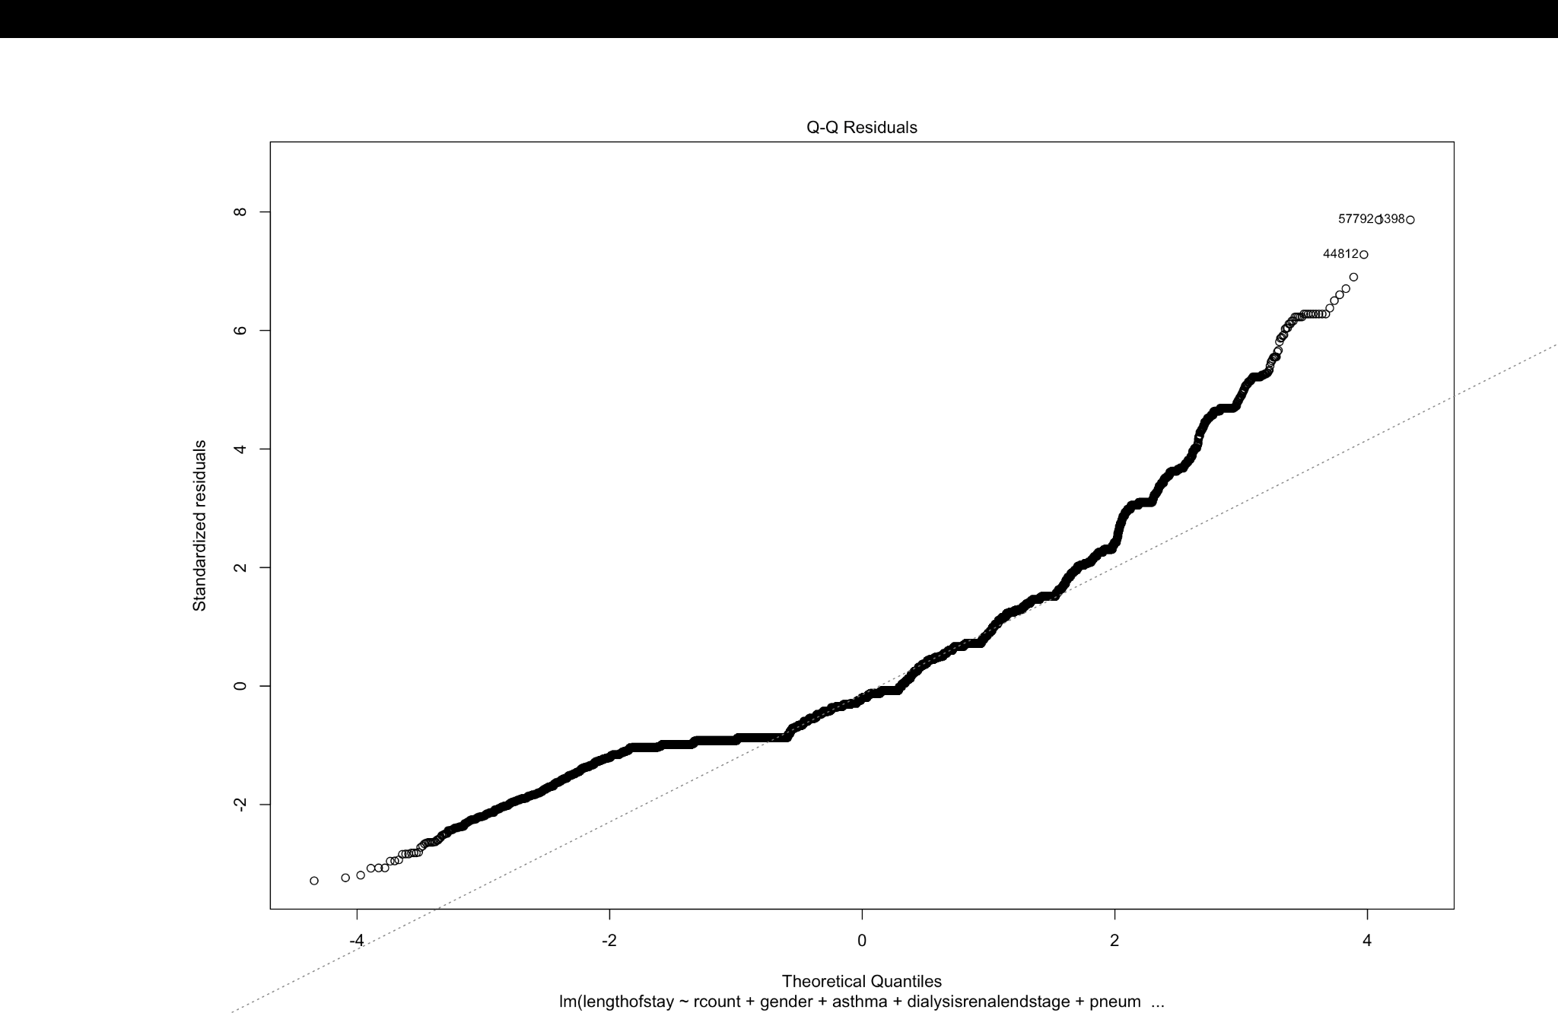
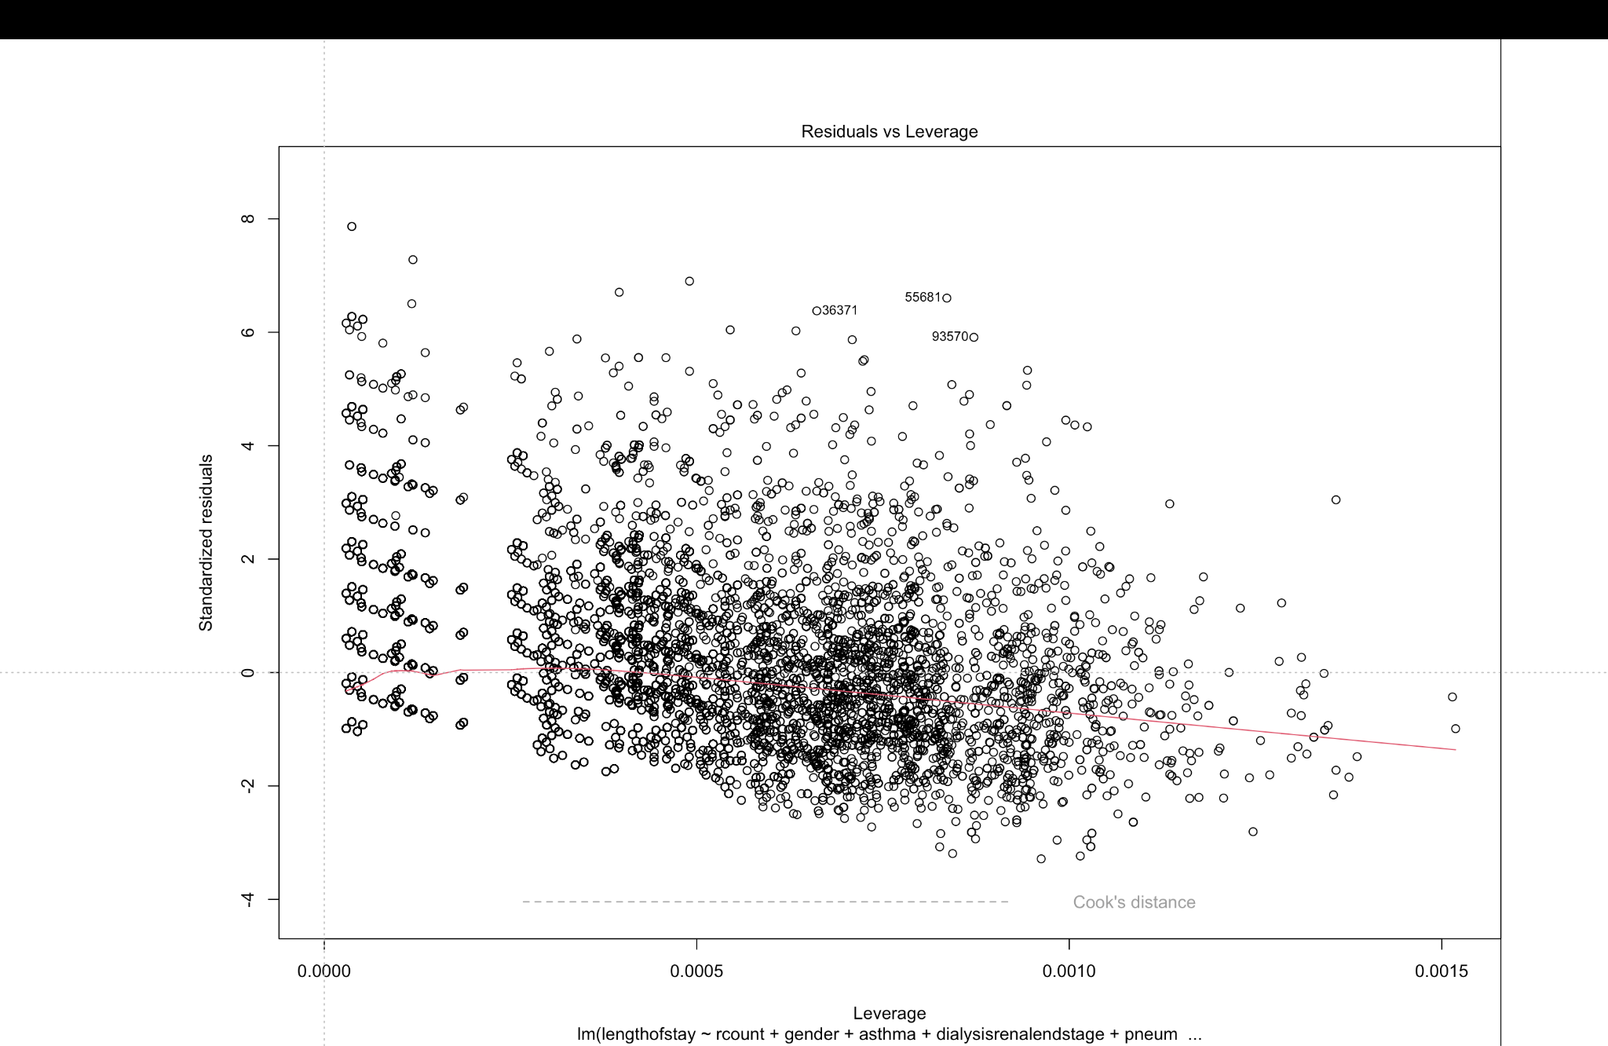
Quantile-Quantile Plot and Homoscedasticity
Checking the linear relationship between Factors and Length of stay by inspecting normal distribution.
Since the residuals are not exactly on the diagonal line it is not a clear normal distribution.
From the result we can say there is no Homoscedasticity as shown in the graph of Residuals V/S Fitted.

Slide 10
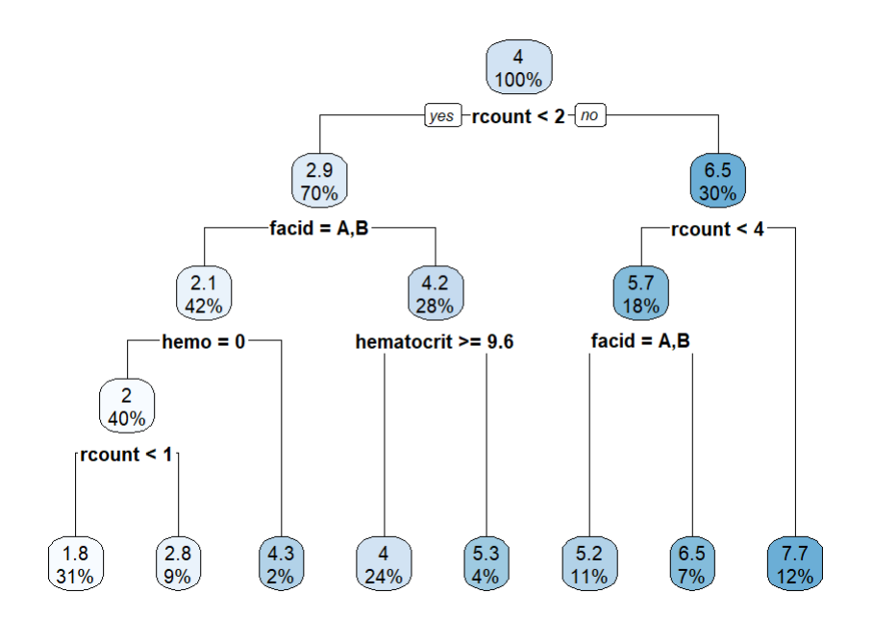
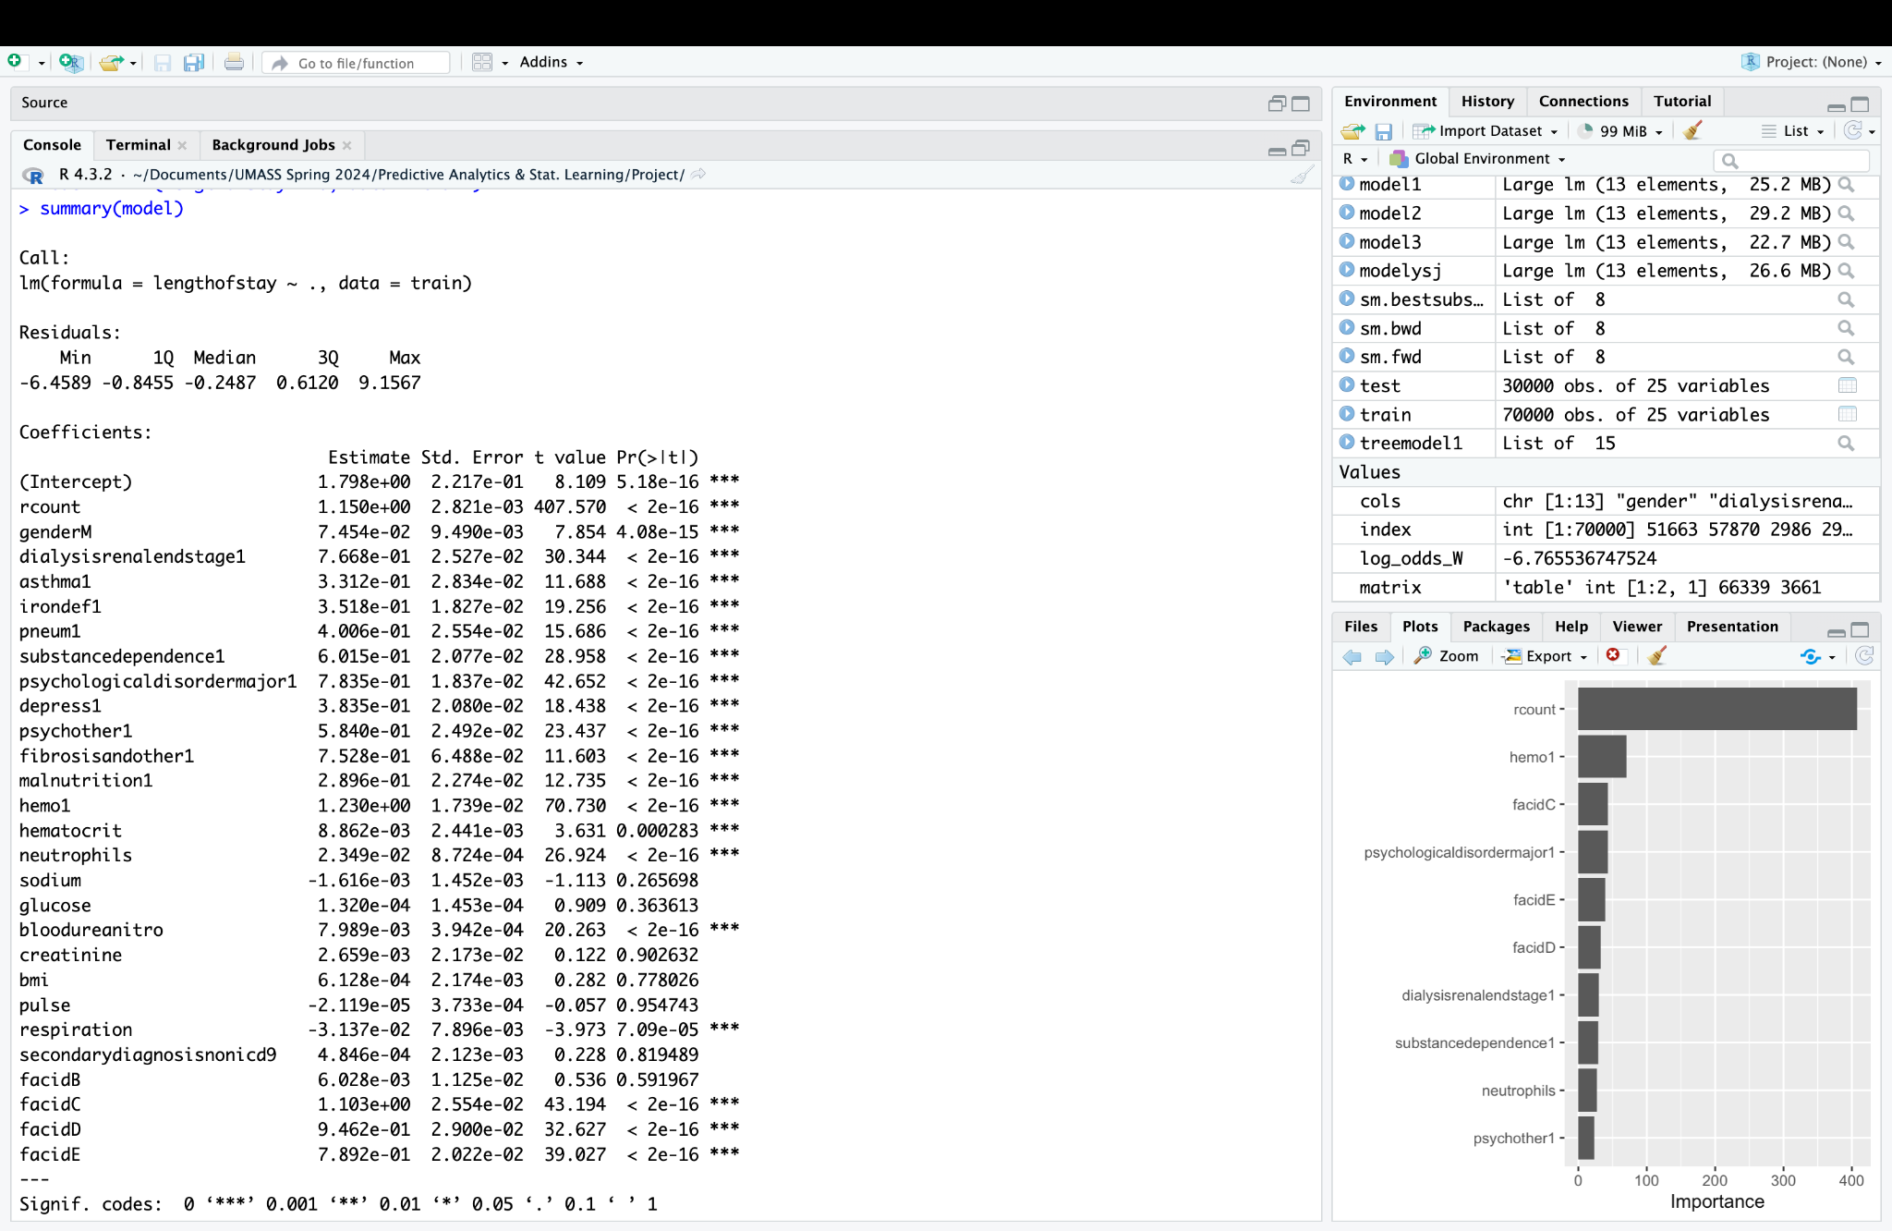
New Approach – Tree Based Model
In examining the decision tree generated, it becomes evident that the variable with the highest significance is the 'R-count,' which denotes the number of readmissions.
This observation aligns logically, considering that a higher 'R-count' implies a greater frequency of hospital admissions. Notably, when the 'R-count' exceeds 4, it serves as a crucial indicator that the patient's length of stay is expected to increase.

Slide 11
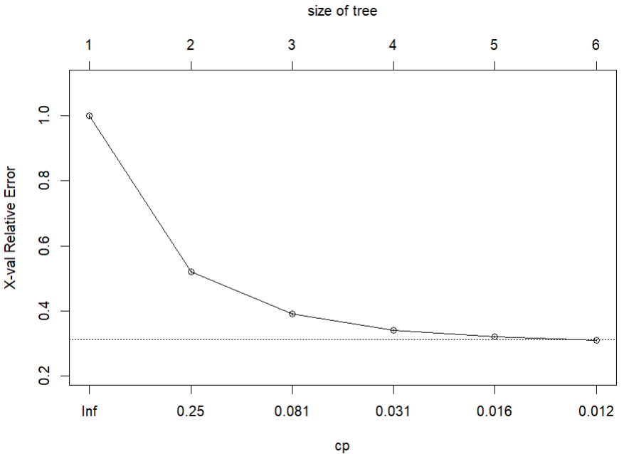
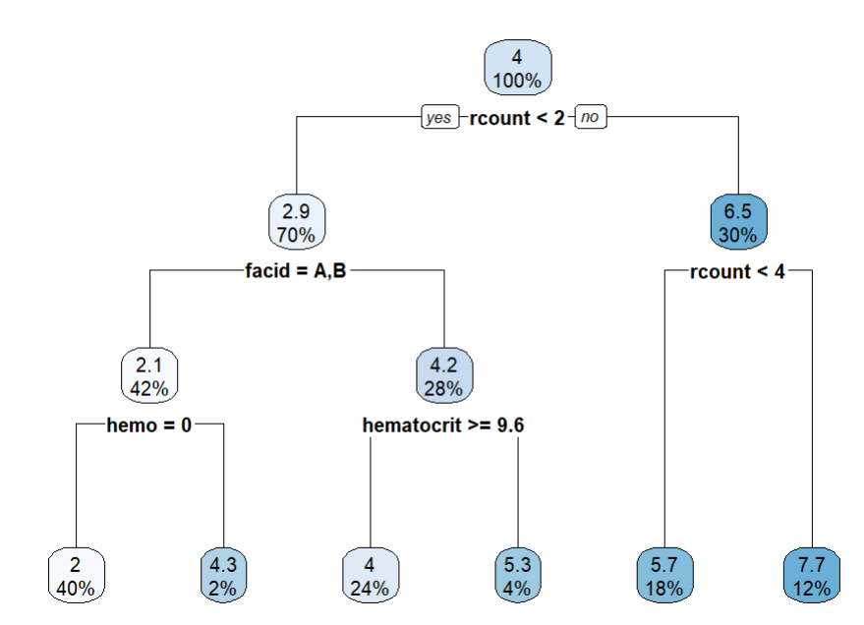
Pruning Decision Tree
We also pruned the decision tree. Since the tree wasn't overly complex, but we aimed to assess if the model's accuracy increased post-pruning.
So as from the cost-complexity plot we choose 0.012 as the cp value to prune the tree which results in 6 leaf nodes tree
Our initial split for division is based on 'rcount,' which serves as our root node. Following this, the subsequent splitting nodes include 'facid' (Facility ID), 'rcount,' 'hemo,' and 'hematocrit.'
The second branch comprises variables such as 'facid' and 'rcount,' indicating the facility where the patient is being treated.
This inference is substantiated by the model's predicted numerical outcome, indicating an average hospital stay of 7.7 days for individuals surpassing the threshold of 4 rcount.

Slide 12
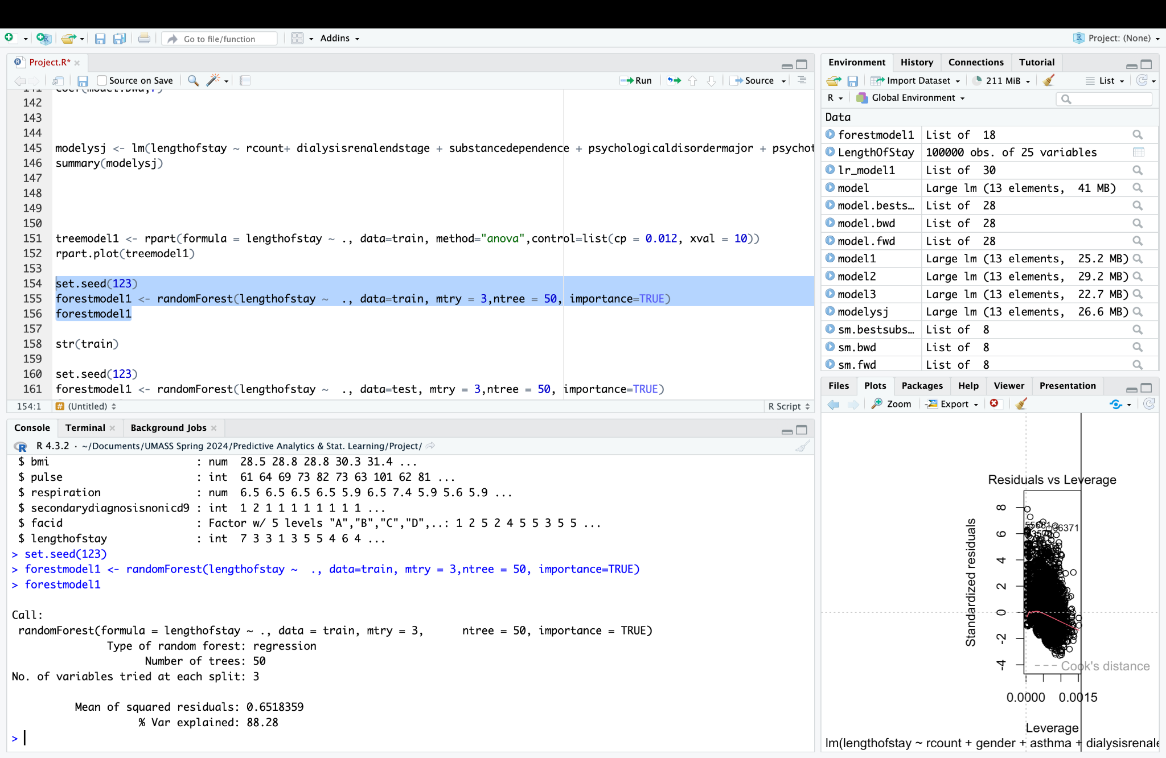
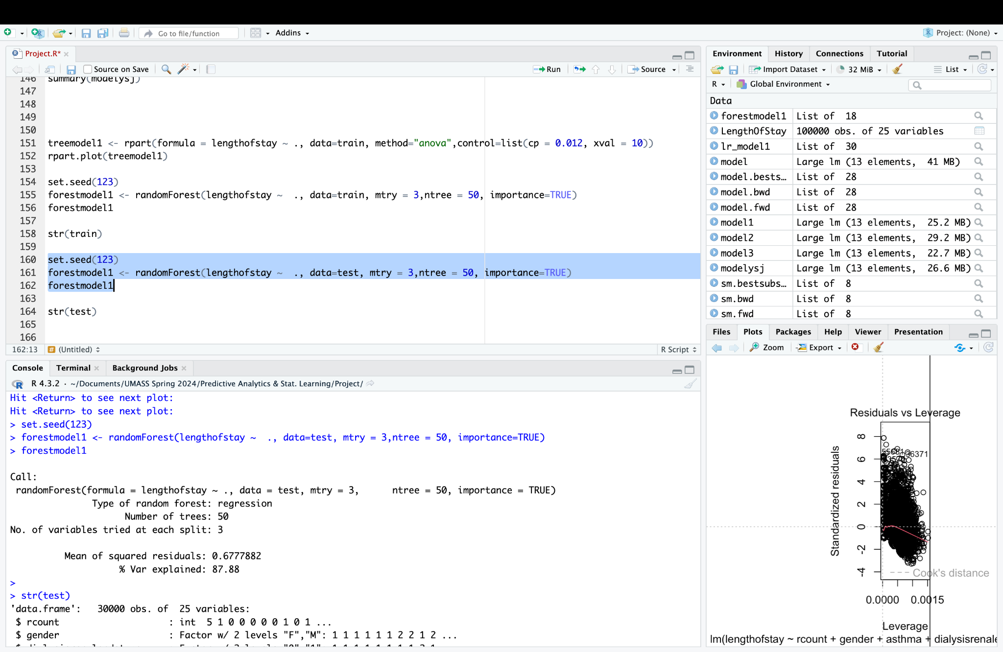
Random Forest
In our analysis using a random forest model, we took into account all available variables to predict outcomes related to hospital stays or patient outcomes. Instead of considering all variables simultaneously, we grouped them into sets of three and used these sets to build decision trees within the random forest.
This approach helps manage overfitting. The results of our analysis showed a Root Mean Square Error (RMSE) of 0.8 days, indicating that, on average, the model's predictions were off by approximately 0.8 days compared to the actual length of hospital stays. Additionally, the model explained 87.88% of the variance, suggesting that it captures a significant portion of the variability in the data.
Overall, these findings suggest that the random forest model performs well in predicting hospital stay lengths based on the variables included in our analysis.

Slide 13
Conclusion
Forecasting the duration of hospital stays is more streamlined when leveraging established variables, as opposed to variables of unknown origin or those detected during operational procedures.
Substance dependence and psychological disorders emerge as pivotal factors in evaluating depressive conditions.
Patients with a heightened frequency of readmissions tend to experience extended periods of hospitalization.
Key parameters for forecasting the duration of hospital stays encompass rcount, faceid, hemo, and hematocrit.

Slide 14
Recommendations
Accurately predicting the patient’s length of stay can help the hospitals in better allocate resources, such as hospital beds, staff scheduling, and other facilities.
This information can aid in optimizing hospital capacity utilization, reducing overcrowding, and improving patient flow management.
Length of stay is a crucial factor in determining the overall cost of a patient's hospitalization.
By predicting the expected length of stay, hospitals can better estimate the associated costs and plan their budgets more effectively.
This dataset was likely chosen because it provides a real-world scenario for predicting patient outcomes, which has significant implications in healthcare resource allocation and patient care.

Slide 15
Thank You

